Slide 1
(a very short introduction to)
digital logic

Slide 2
what is computation?
Notes:
open ended… how do we think about machine computation and biological computation?

Slide 3
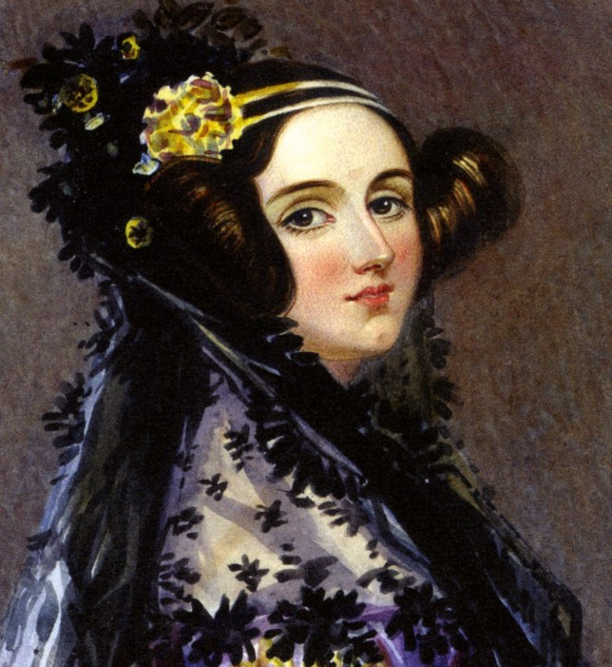
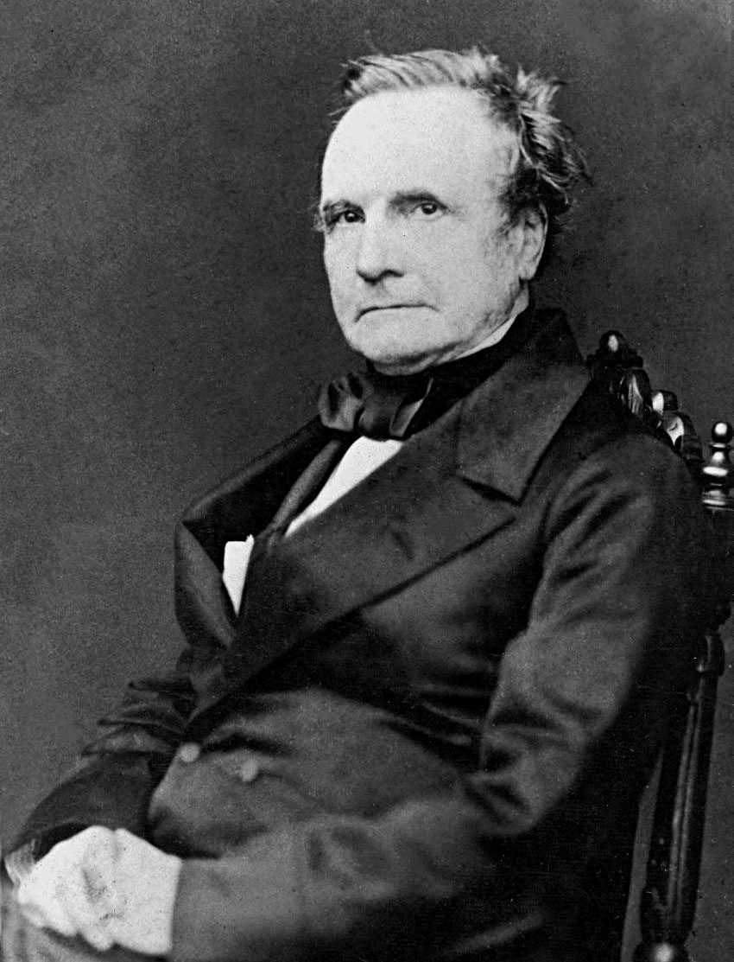
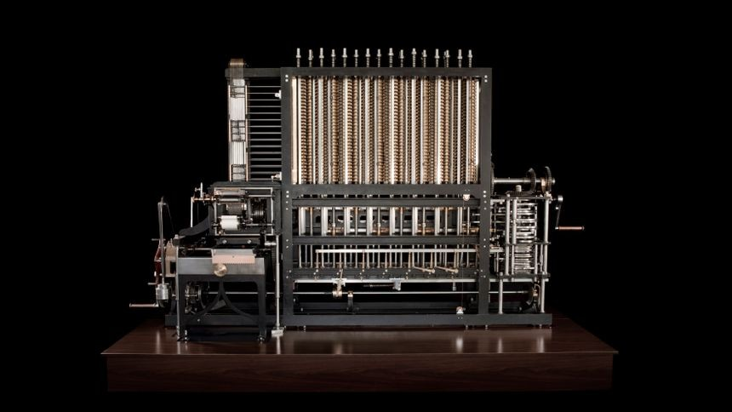
gears
Notes:
1822 — tabulate polynomials by finite differences (subtract and add to previous values) — in the Science Museum
Babbage's proposed Analytical Engine, considerably more ambitious than the Difference Engine, was to have been a general-purpose mechanical digital computer. The Analytical Engine was to have had a memory store and a central processing unit (or ‘mill’) and would have been able to select from among alternative actions consequent upon the outcome of its previous actions (a facility nowadays known as conditional branching). The behaviour of the Analytical Engine would have been controlled by a program of instructions contained on punched cards connected together with ribbons (an idea that Babbage had adopted from the Jacquard weaving loom). Babbage emphasised the generality of the Analytical Engine, saying ‘the conditions which enable a finite machine to make calculations of unlimited extent are fulfilled in the Analytical Engine’ (Babbage [1994], p. 97).

Slide 4
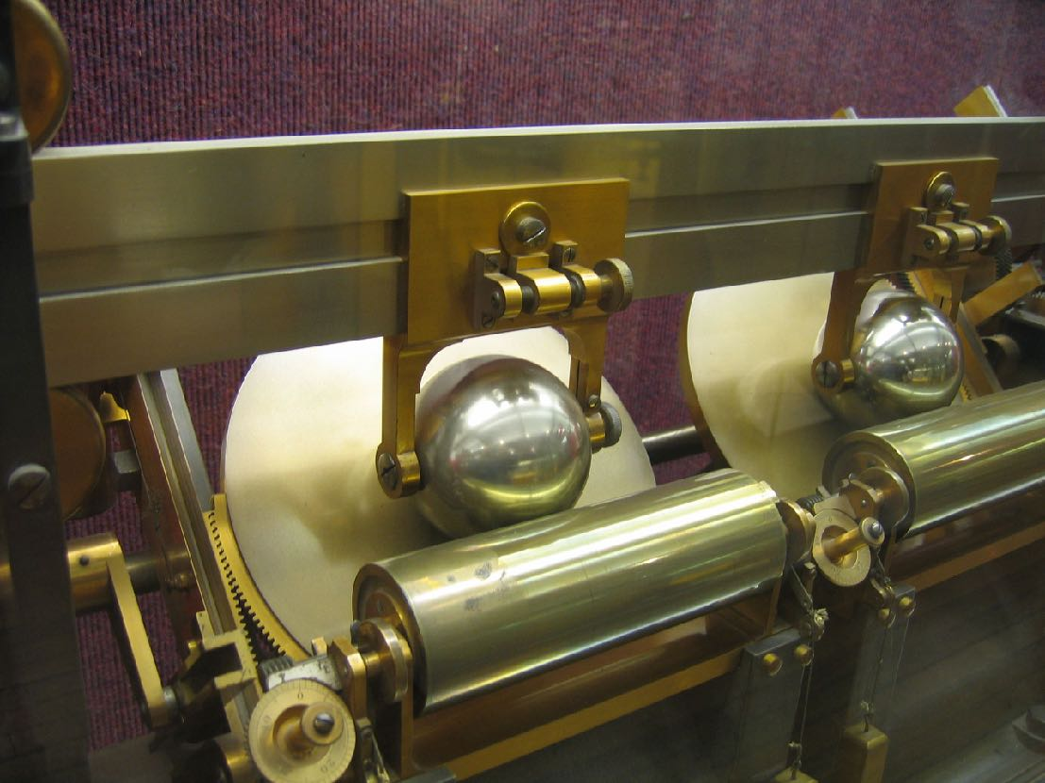
discs
Notes:
1886
adding big numbers together was hard!
Consider an example system that measures the total amount of water flowing through a sluice: A float is attached to the input carriage so the bearing moves up and down with the level of the water. As the water level rises, the bearing is pushed farther from the center of the input disk, increasing the output's rotation rate. By counting the total number of turns of the output shaft (for example, with an odometer-type device), and multiplying by the cross-sectional area of the sluice, the total amount of water flowing past the meter can be determined.
https://en.wikipedia.org/wiki/Ball-and-disk_integrator
Lord Kelvin and his brother James Thomson

Slide 5
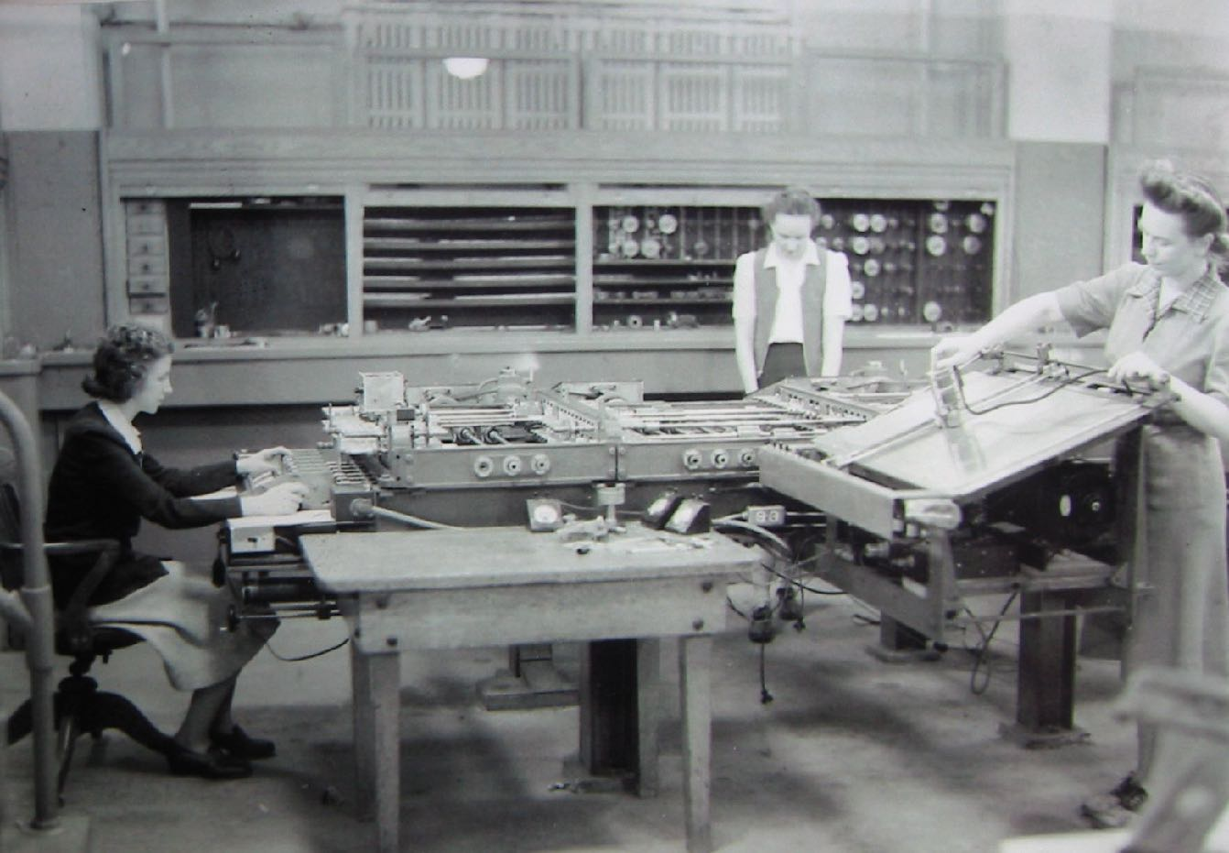
discs
Notes:
Penn 1942 — Differential analyser — Vannevar Bush
“A differential analyser may be conceptualised as a collection of ‘black boxes’ connected together in such a way as to allow considerable feedback. Each box performs a fundamental process, for example addition, multiplication of a variable by a constant, and integration. In setting up the machine for a given task, boxes are connected together so that the desired set of fundamental processes is executed. In the case of electrical machines, this was done typically by plugging wires into sockets on a patch panel (computing machines whose function is determined in this way are referred to as ‘program-controlled’).”

Slide 6
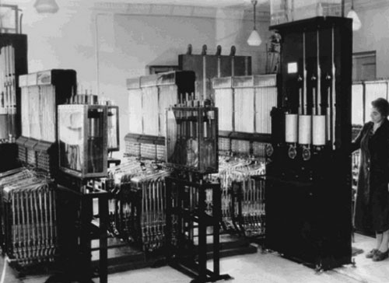
pipes
Notes:
https://en.wikipedia.org/wiki/Water_integrator — 1936
for specific problems and general modular system
The water level in various chambers (with precision to fractions of a millimeter) represented stored numbers, and the rate of flow between them represented mathematical operations. This machine was capable of solving inhomogeneous differential equations.
https://history-computer.com/CalculatingTools/AnalogComputers/Lukianov.html.
Vladimir Lukianov — solving PDEs for temperature distributions / heat equations in concrete (for railway design) — changed temperature to water pressure and flow rate
In 1941, Lukyanov created a hydraulic integrator of modular design, which made it possible to assemble a machine for solving various problems. Two-dimensional and three-dimensional hydraulic integrators were designed.

Slide 7
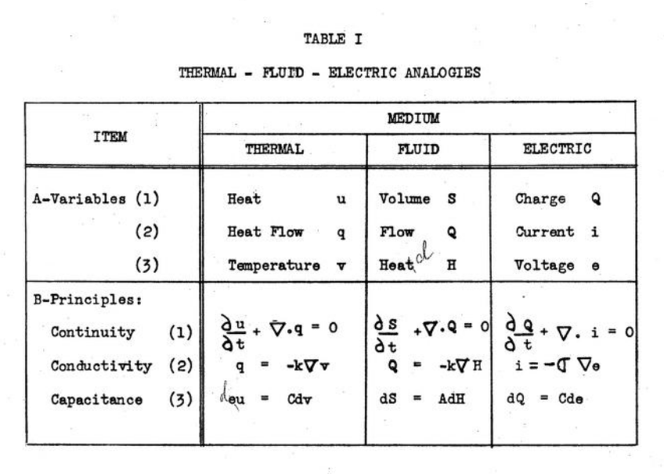
Notes:
this is from a 1953 technical report from US army / MIT Civil Eng about analog computing

Slide 8
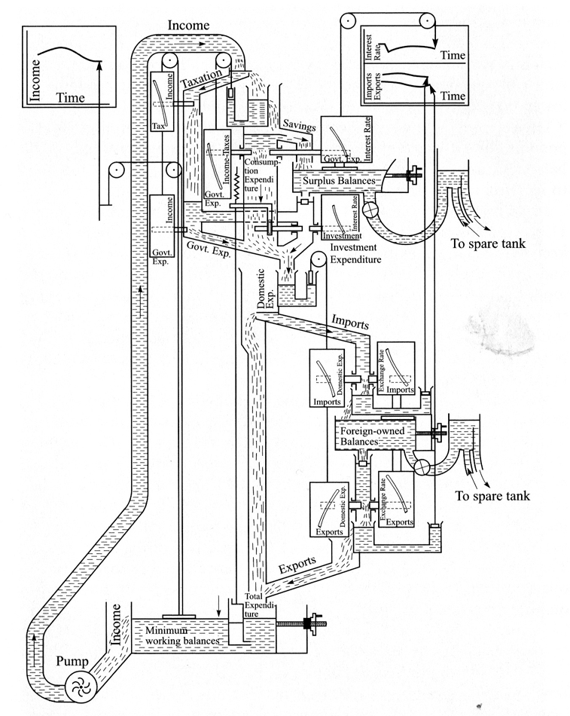
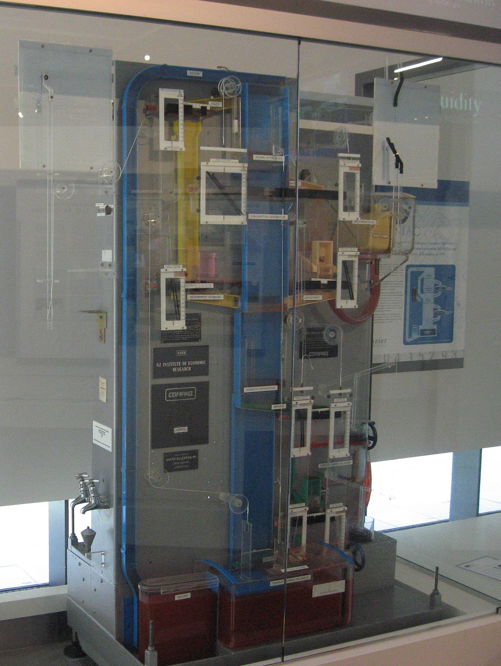
Notes:
MONIAC — LSE 1949 — inputs and outputs for a simulated economy
monetary national income analogue computer
~2% precision with digital/analytical techniques

Slide 9
what is digital?
Notes:
What is a "digital circuit"?
- there are only ever two voltage levels
"any project with more than 3 ICs should just use a microcontroller”
etymology of digital—
finger or toe — number less than 10
leibniz proposed binary number system 1660s
boole proposed a system of binary logic 1840s
wittgenstein proposed truth tables (1921)
charles sanders pierce proposed electrical switches for logical computations — 1886
etymology of data —
- "from the practice of signing letters in Latin by noting the date on which they were dispatched"
- latin datus, *dare =* to **give, what has been given
Why do we need logic?
boolean logic is how we describe and simplify circuits
How do we implement logic in circuits?
What can we make with hardware logic?
- any instruction set can be represented as binary
- boolean algebra applied to such instructions / data can generate arbitrary computations with enough time and memory (see later discussions of interpretation/compilation)

Slide 10
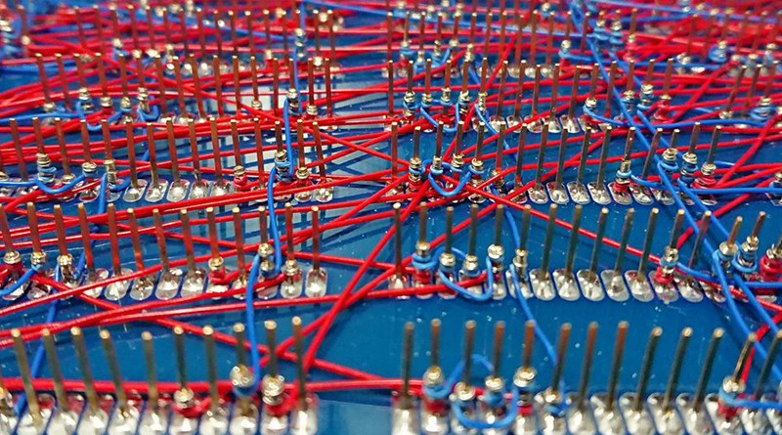
relays
Notes:
electro(mechanical) switch
ARRA, Harvard Mark II, Zuse Z2, and Zuse Z3
literally an electromagnetic switching device

Slide 11
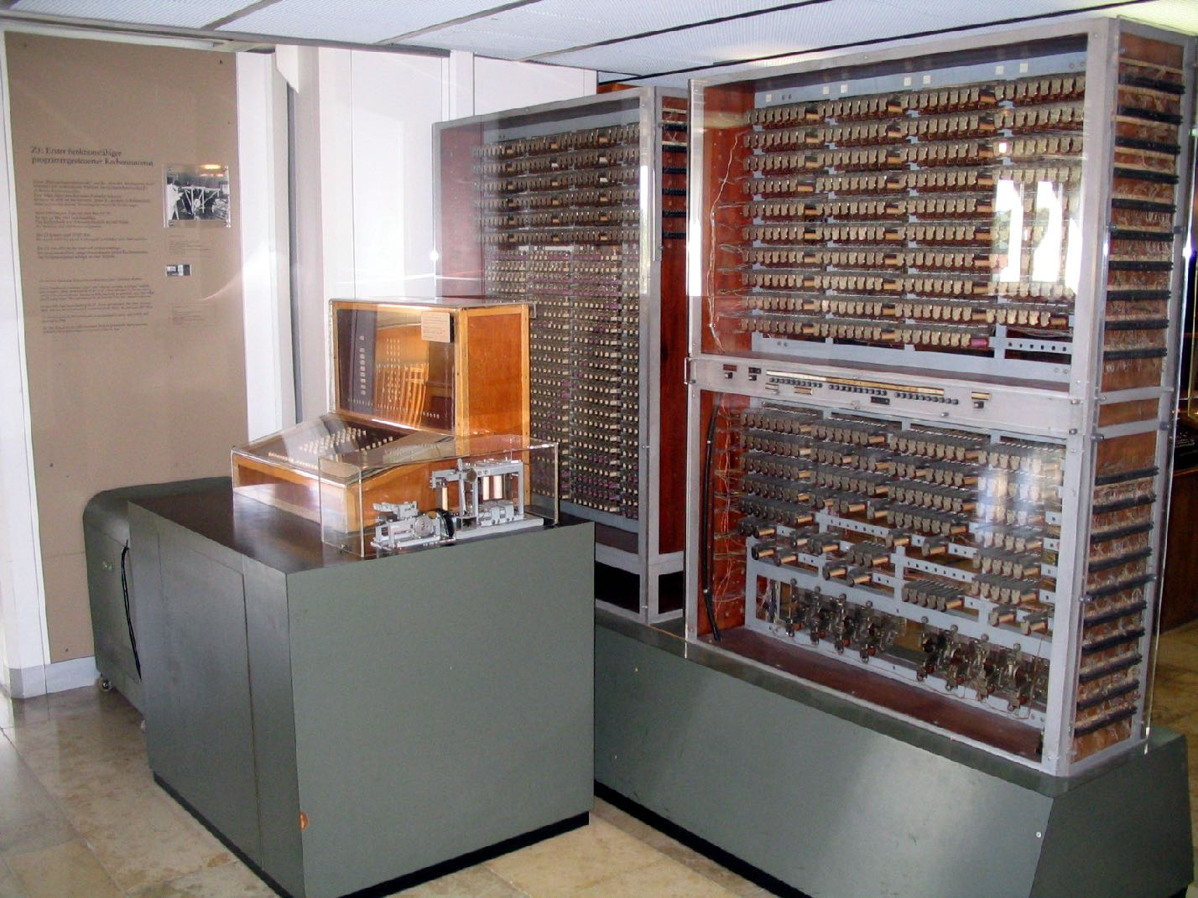
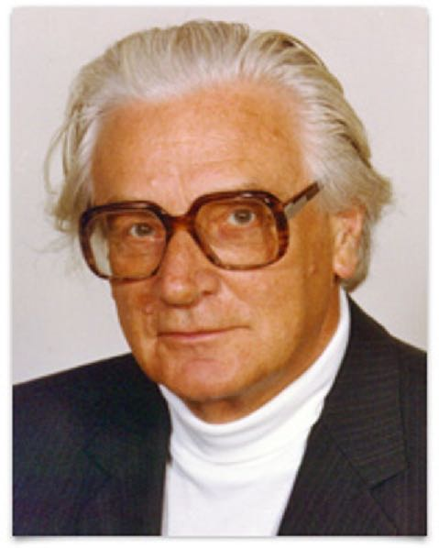
the first computer?
Notes:
The Z2 was a mechanical and relay computer completed by Konrad Zuse in 1940. It was an improvement on the Z1, using the same mechanical memory but replacing the arithmetic and control logic with electrical relay circuits.
Konrad Zuse's Z3 was the world's first working programmable, fully automatic computer, with binary digital arithmetic logic, but it lacked the conditional branching of a Turing machine.
300lb
1kW

Slide 12
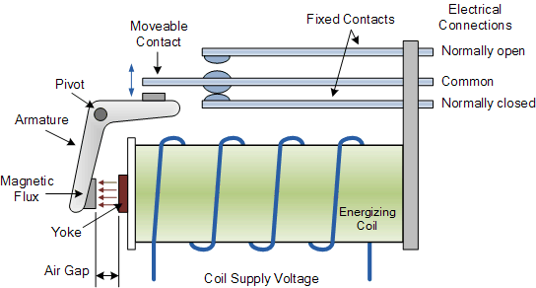
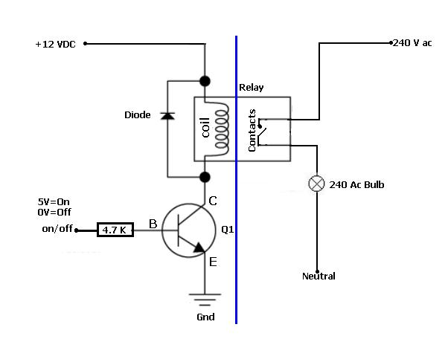

Slide 13
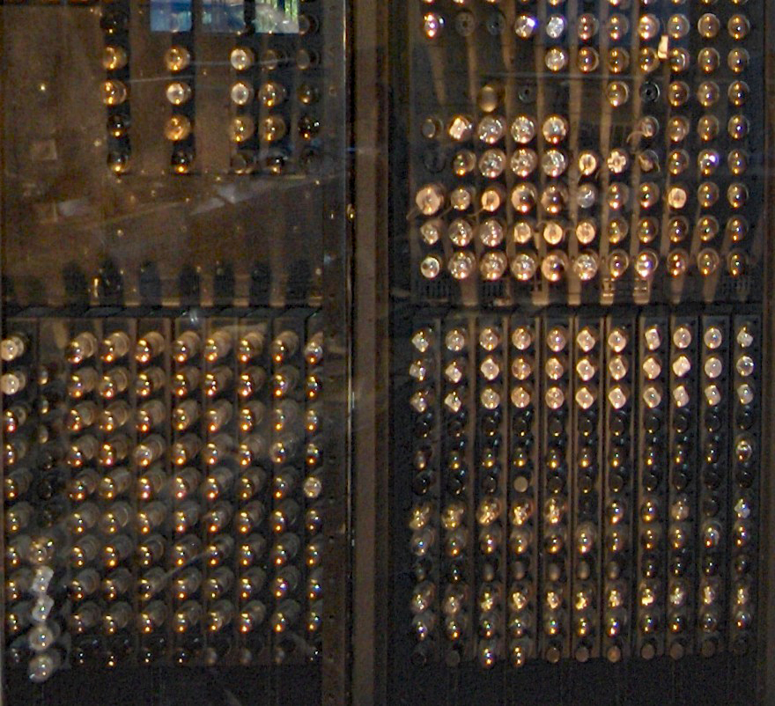
vacuum tubes
Notes:
It was the development of high-speed digital techniques using vacuum tubes that made the modern computer possible.
Tommy Flowers — British Post Office, used for telephone exchanges
triodes as switches — heat the cathode, gives of e-’s, change the voltage on the gate (bias) to change the current that can flow through to the anode.
The 1946 ENIAC computer used 17,468 vacuum tubes and consumed 150 kW of power
Colossus

Slide 14
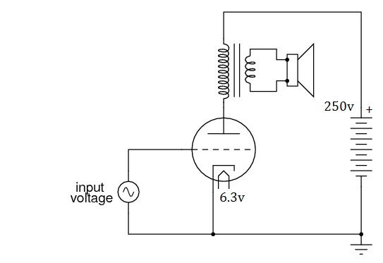
Notes:
cathode heats up, throws off electrons
anode positively charged, current flows
Electronics at Work
https://www.youtube.com/watch?v=hwutHPYGgfU

Slide 15
Notes:
Colossus — 1600 thyratron/thermionic tube — 1943-45
Colossus lacked two important features of modern computers. First, it had no internally stored programs. To set it up for a new task, the operator had to alter the machine's physical wiring, using plugs and switches. Second, Colossus was not a general-purpose machine, being designed for a specific cryptanalytic task involving counting and Boolean operations.
150kW

Slide 16
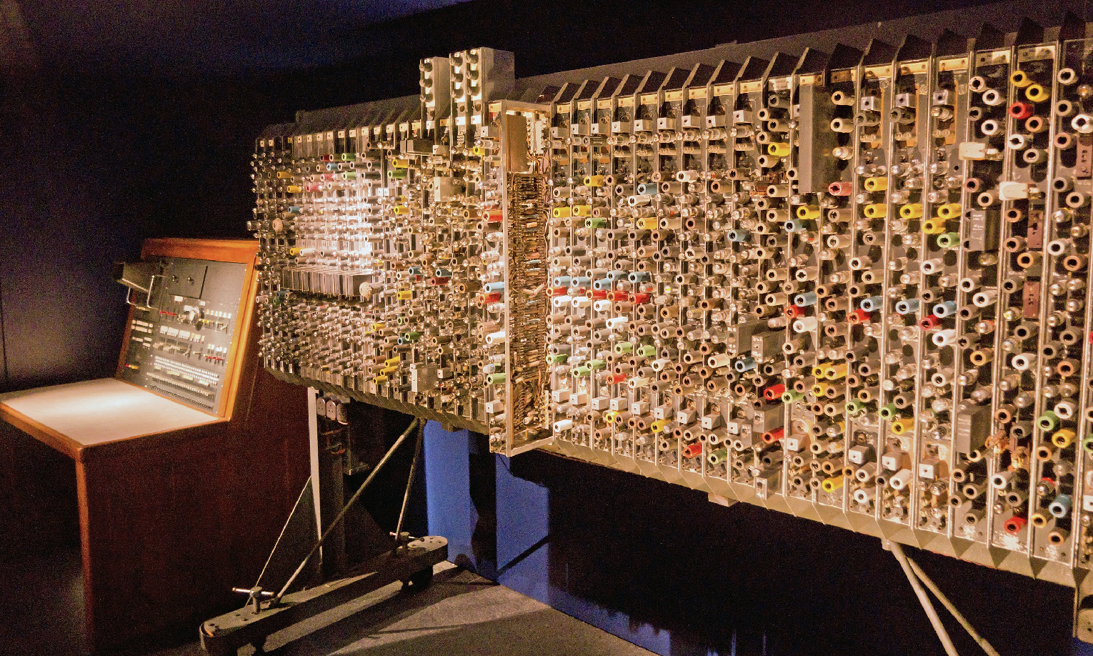
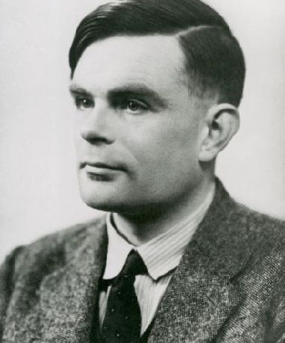
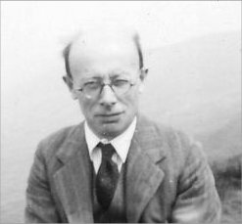
Notes:
ACE Computer — Manchester
Max Newman established the Royal Society Computing Machine Laboratory at the University of Manchester, which produced the world's first working, electronic stored-program electronic computer in 1948, the Manchester Baby. Also Bletchley park colossus research
Turing's design had much in common with today's RISC architectures and it called for a high-speed memory of roughly the same capacity as an early Macintosh computer (enormous by the standards of his day).
With an operating speed of 1 MHz, the Pilot Model ACE was for some time the fastest computer in the world.
…all the essential ideas of the general-purpose calculating machines now being made are to be found in Babbage's plans for his analytical engine. In modern times the idea of a universal calculating machine was independently introduced by Turing … [T]he machines now being made in America and in this country … [are] in certain general respects … all similar. There is provision for storing numbers, say in the scale of 2, so that each number appears as a row of, say, forty 0's and 1's in certain places or "houses" in the machine. … Certain of these numbers, or "words" are read, one after another, as orders. In one possible type of machine an order consists of four numbers, for example 11, 13, 27, 4. The number 4 signifies "add", and when control shifts to this word the "houses" H11 and H13 will be connected to the adder as inputs, and H27 as output. The numbers stored in H11 and H13 pass through the adder, are added, and the sum is passed on to H27. The control then shifts to the next order.

Slide 17
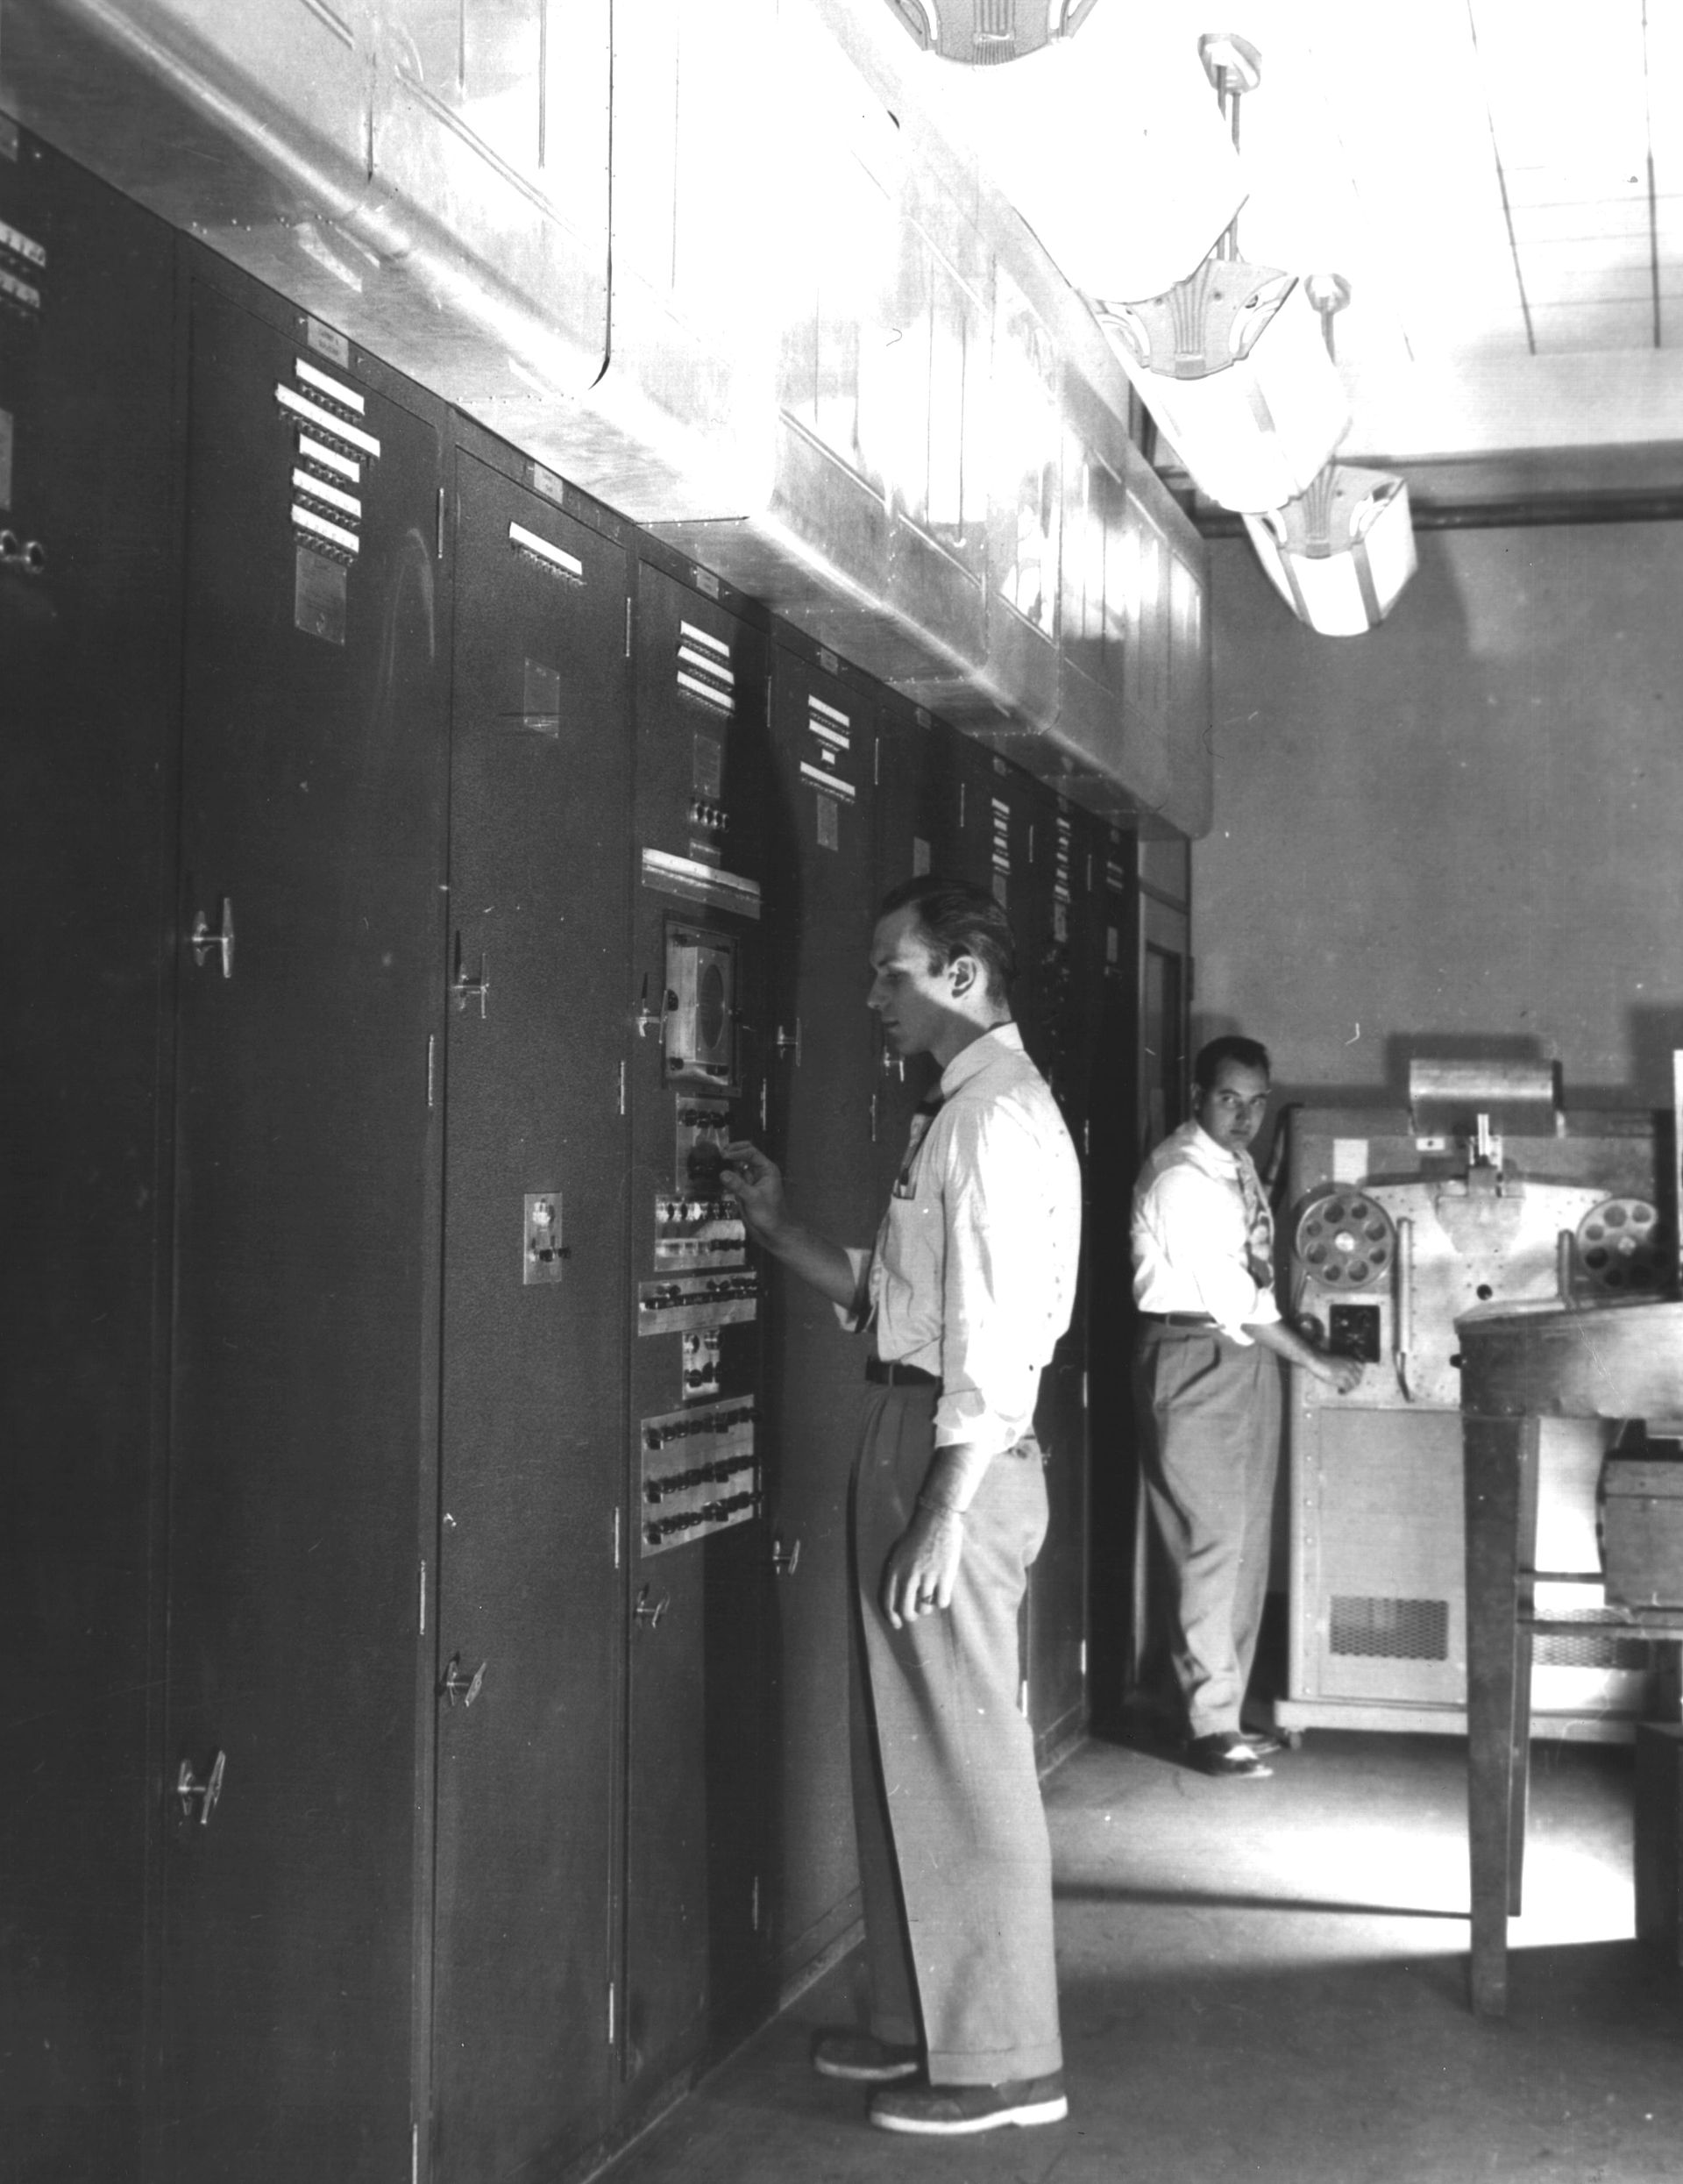
Notes:
EDVAC — Electronic Discrete Variable Automatic Computer (binary)
used for missile trajectories
The ENIAC (1946) was the first machine that was both electronic and general purpose. It was Turing complete, with conditional branching, and programmable to solve a wide range of problems, but its program was held in the state of switches in patchcords, not in memory, and it could take several days to reprogram.

Slide 18
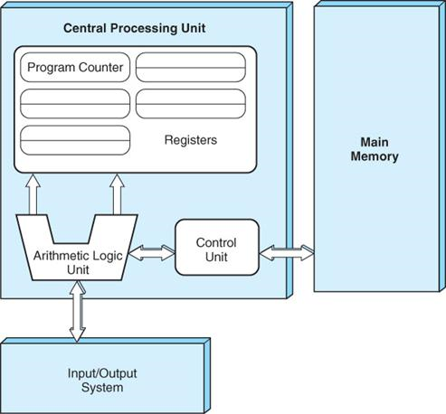
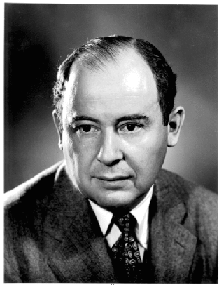
How does this compare to the brain?
Notes:
John realized that “Data” and a “Program” do not require distinct substrates…they can be stored in the same hardware, system memory (often RAM) and then processed by a separate CPU.
https://en.wikipedia.org/wiki/Von_Neumann_architecture#Von_Neumann_bottleneck
comes from turing’s work on stored program concept
The original Harvard architecture computer, the Harvard Mark I, employed entirely separate memory systems to store instructions and data. The CPU fetched the next instruction and loaded or stored data simultaneously and independently. This is in contrast to a von Neumann architecture computer, in which both instructions and data are stored in the same memory system and (without the complexity of a CPU cache) must be accessed in turn. The physical separation of instruction and data memory is sometimes held to be the distinguishing feature of modern Harvard architecture computers. With microcontrollers (entire computer systems integrated onto single chips), the use of different memory technologies for instructions (e.g. flash memory) and data (typically read/write memory) in von Neumann machines is becoming popular. The true distinction of a Harvard machine is that instruction and data memory occupy different address spaces. In other words, a memory address does not uniquely identify a storage location (as it does in a von Neumann machine); it is also necessary to know the memory space (instruction or data) to which the address belongs.
Modern functional programming and object-oriented programming are much less geared towards "pushing vast numbers of words back and forth" than earlier languages like FORTRAN were, but internally, that is still what computers spend much of their time doing, even highly parallel supercomputers.
As of 1996, a database benchmark study found that three out of four CPU cycles were spent waiting for memory. Researchers expect that increasing the number of simultaneous instruction streams with multithreading or single-chip multiprocessing will make this bottleneck even worse.[28] In the context of multi-core processors, additional overhead is required to maintain cache coherence between processors and threads.

Slide 19
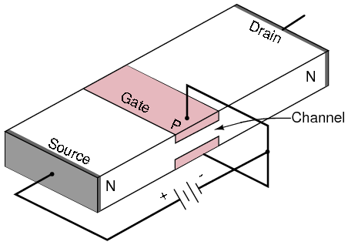
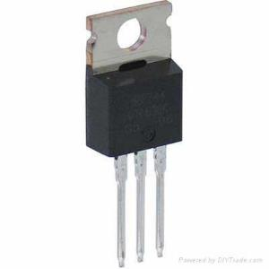
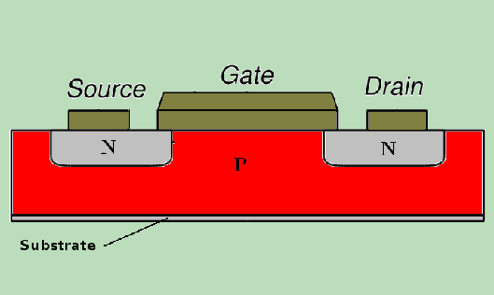
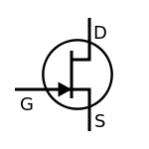
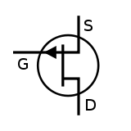
transistors
N-MOSFET
P-MOSFET
pos (+) Gate
neg (-) Gate

Slide 21
PDP-1
Notes:
1959 PDP-1
Programmed Data Processor-1

Slide 22
Spacewar!
Notes:
steve russell

Slide 23
Notes:
how did we get here?

Slide 24
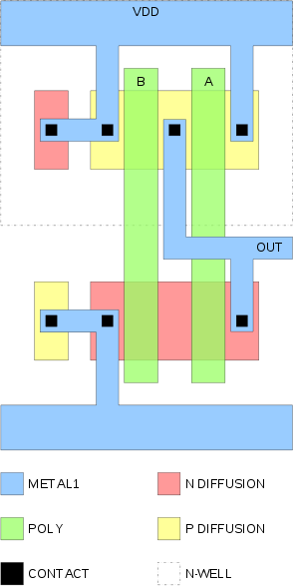
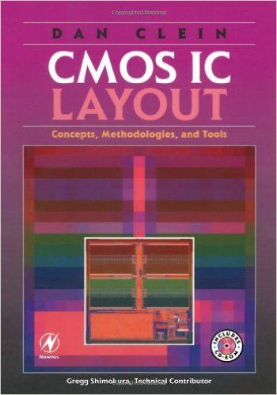

Notes:
1978 carver mead lynn conway = VLSI

Slide 25
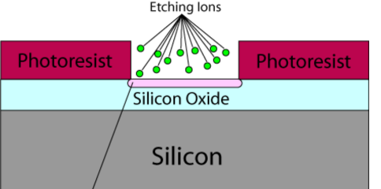
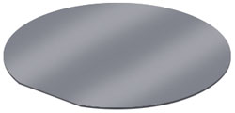
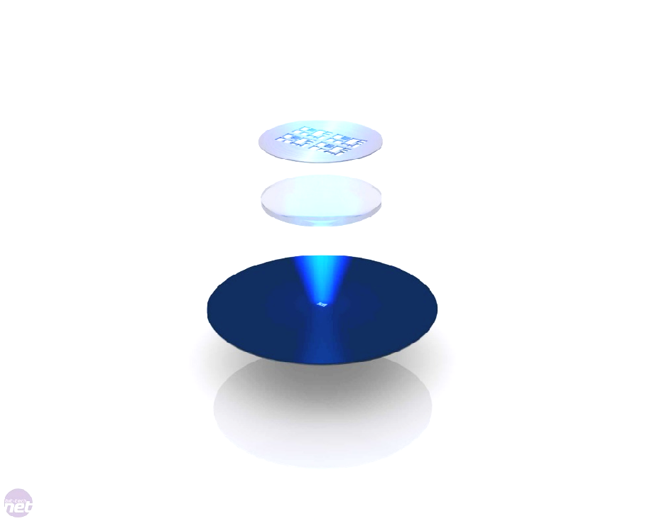
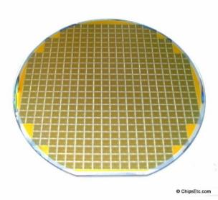
Deposition/Etching
Photolithography
Mask
Silicon Wafer
“On Wafer” Devices
Post-Processing

Slide 26
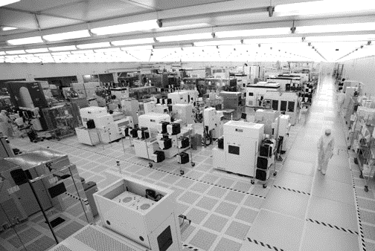
CMOS Fab (cleanroom)

Slide 27
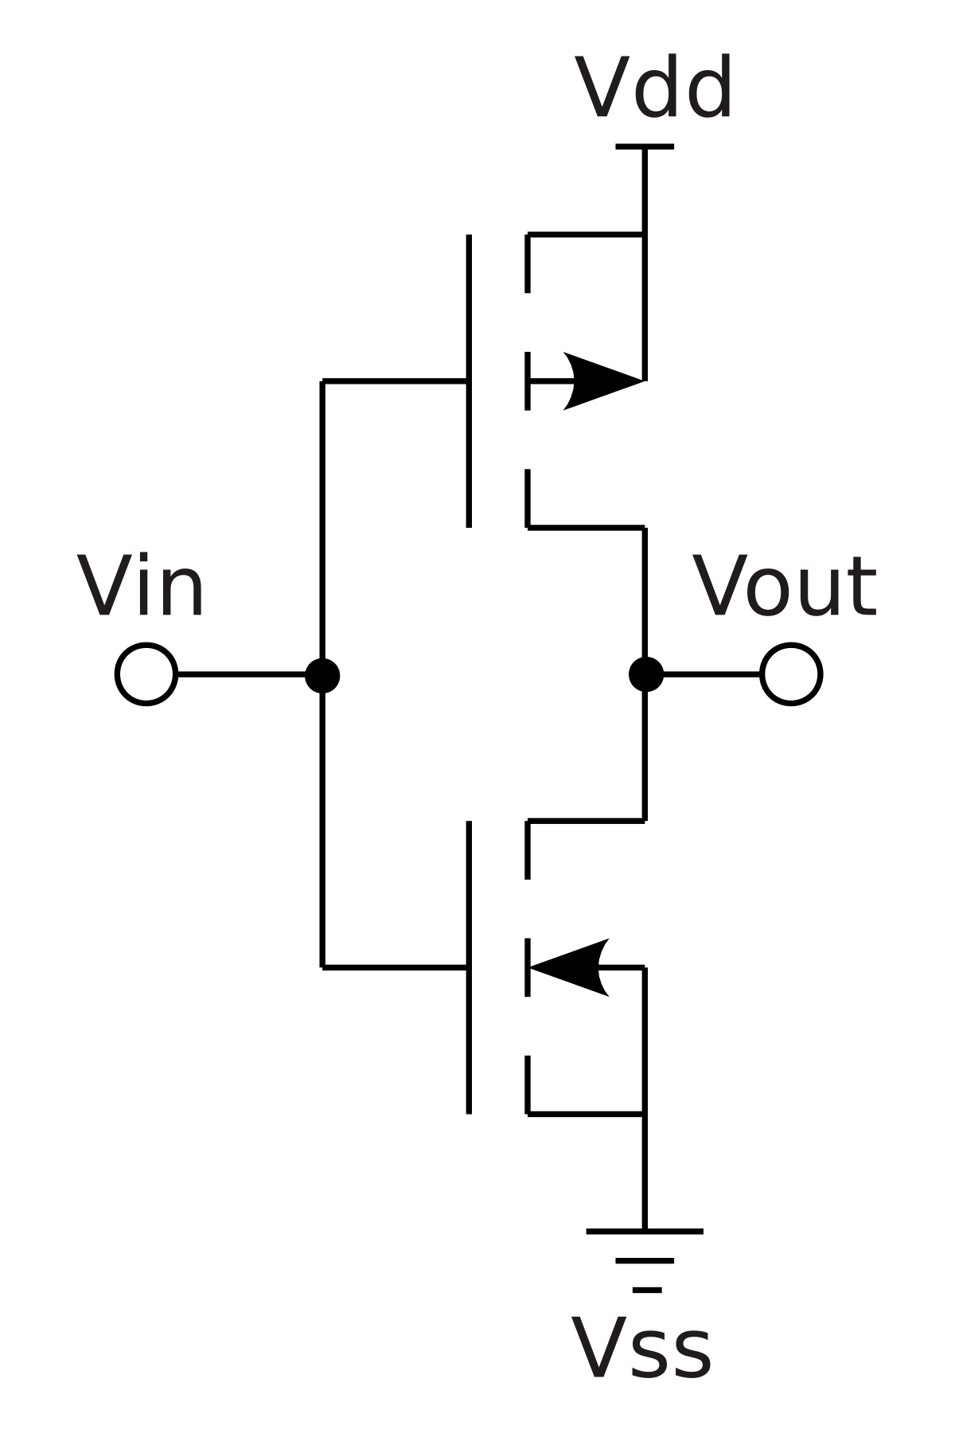
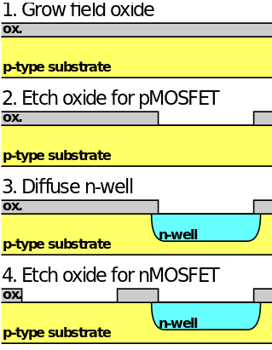
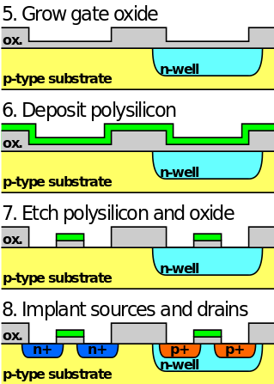
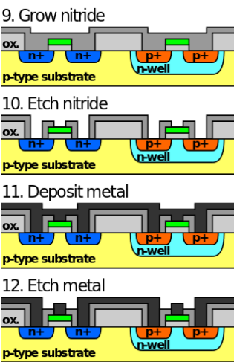
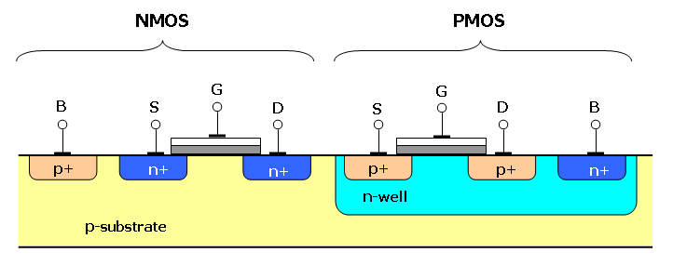
Notes:
nitride is insulator

Slide 28
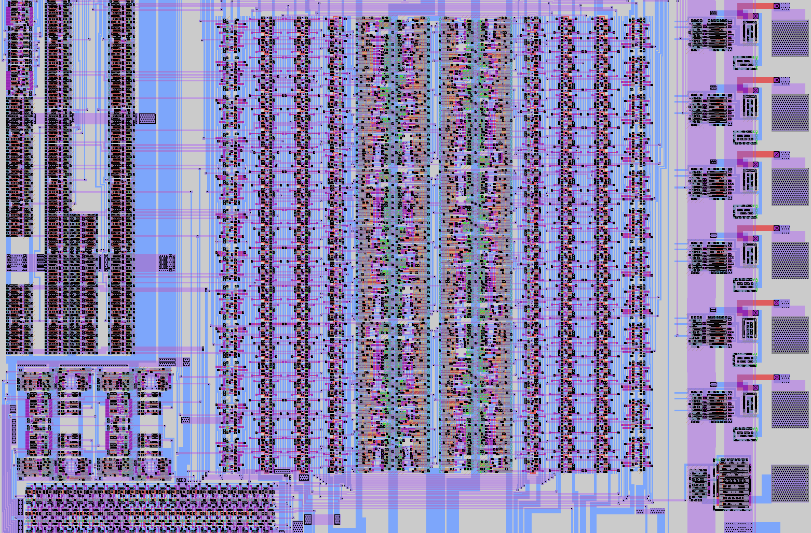

Slide 29
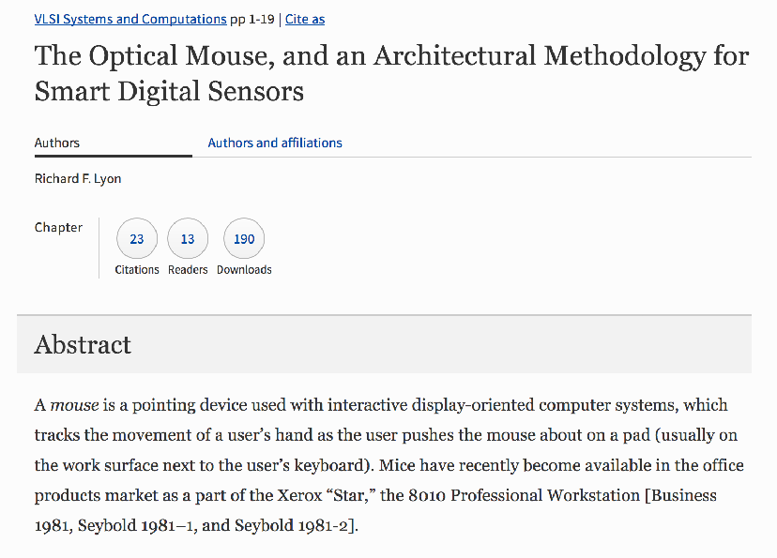
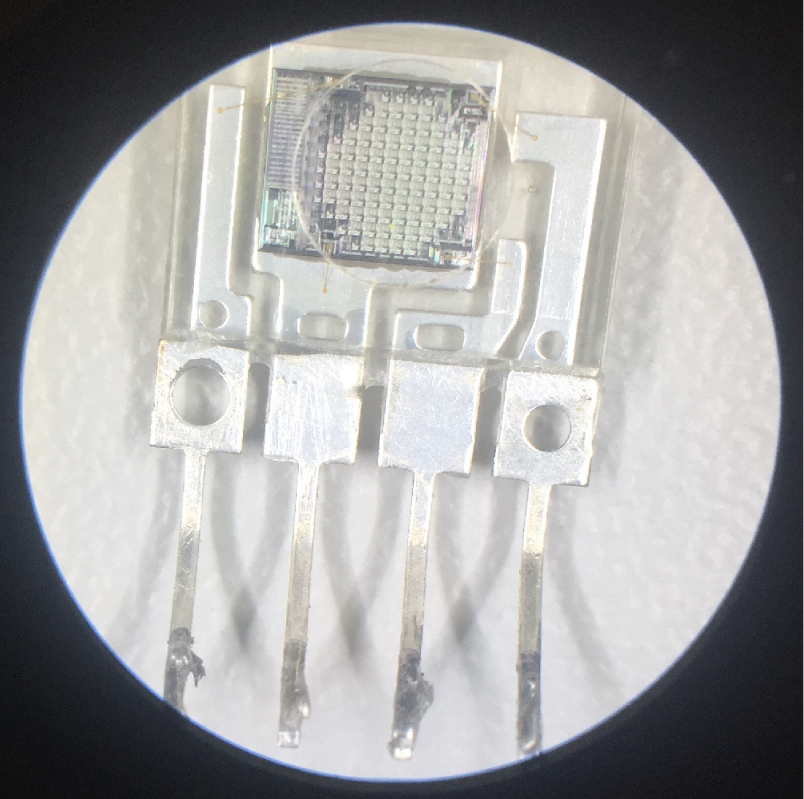
Notes:
richard lyon optical mouse
carver mead, claire conway = vlsi
hearing, touch, vision

Slide 30
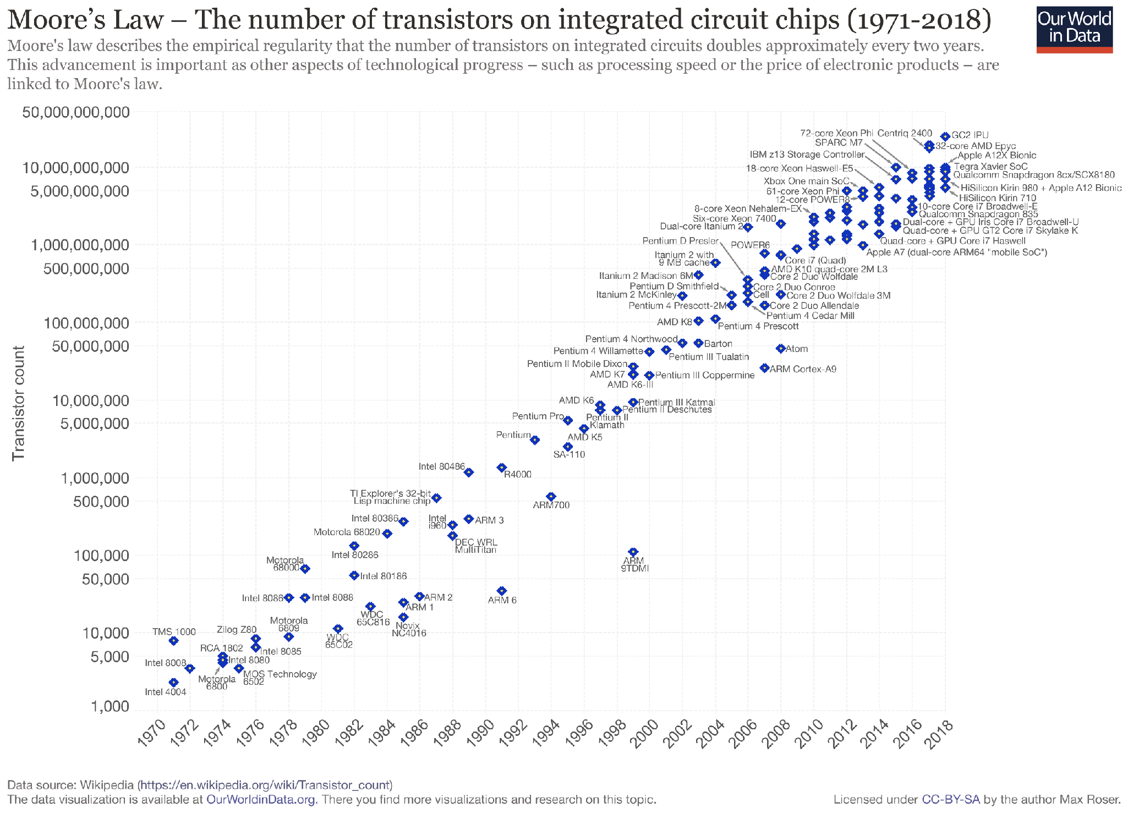

Slide 31
back to boole
Notes:
what does this do?

Slide 32
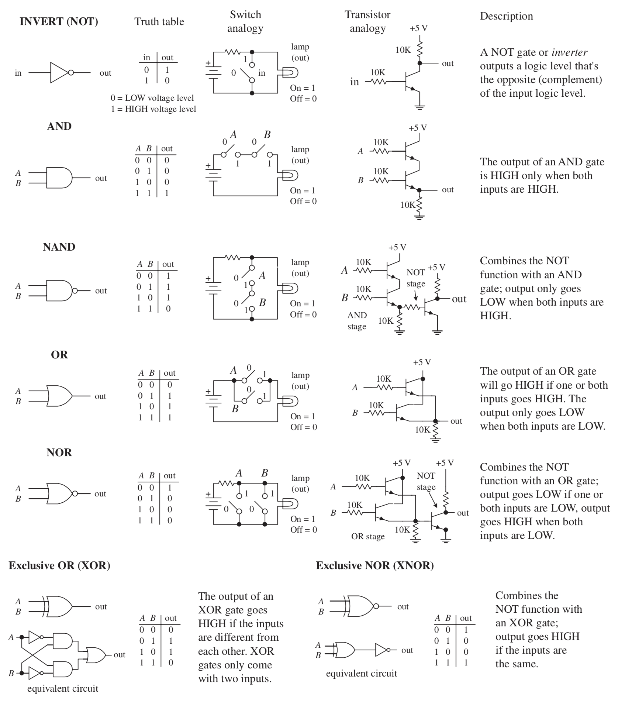
Notes:
go through each basic gate and figure out what each one does

Slide 34
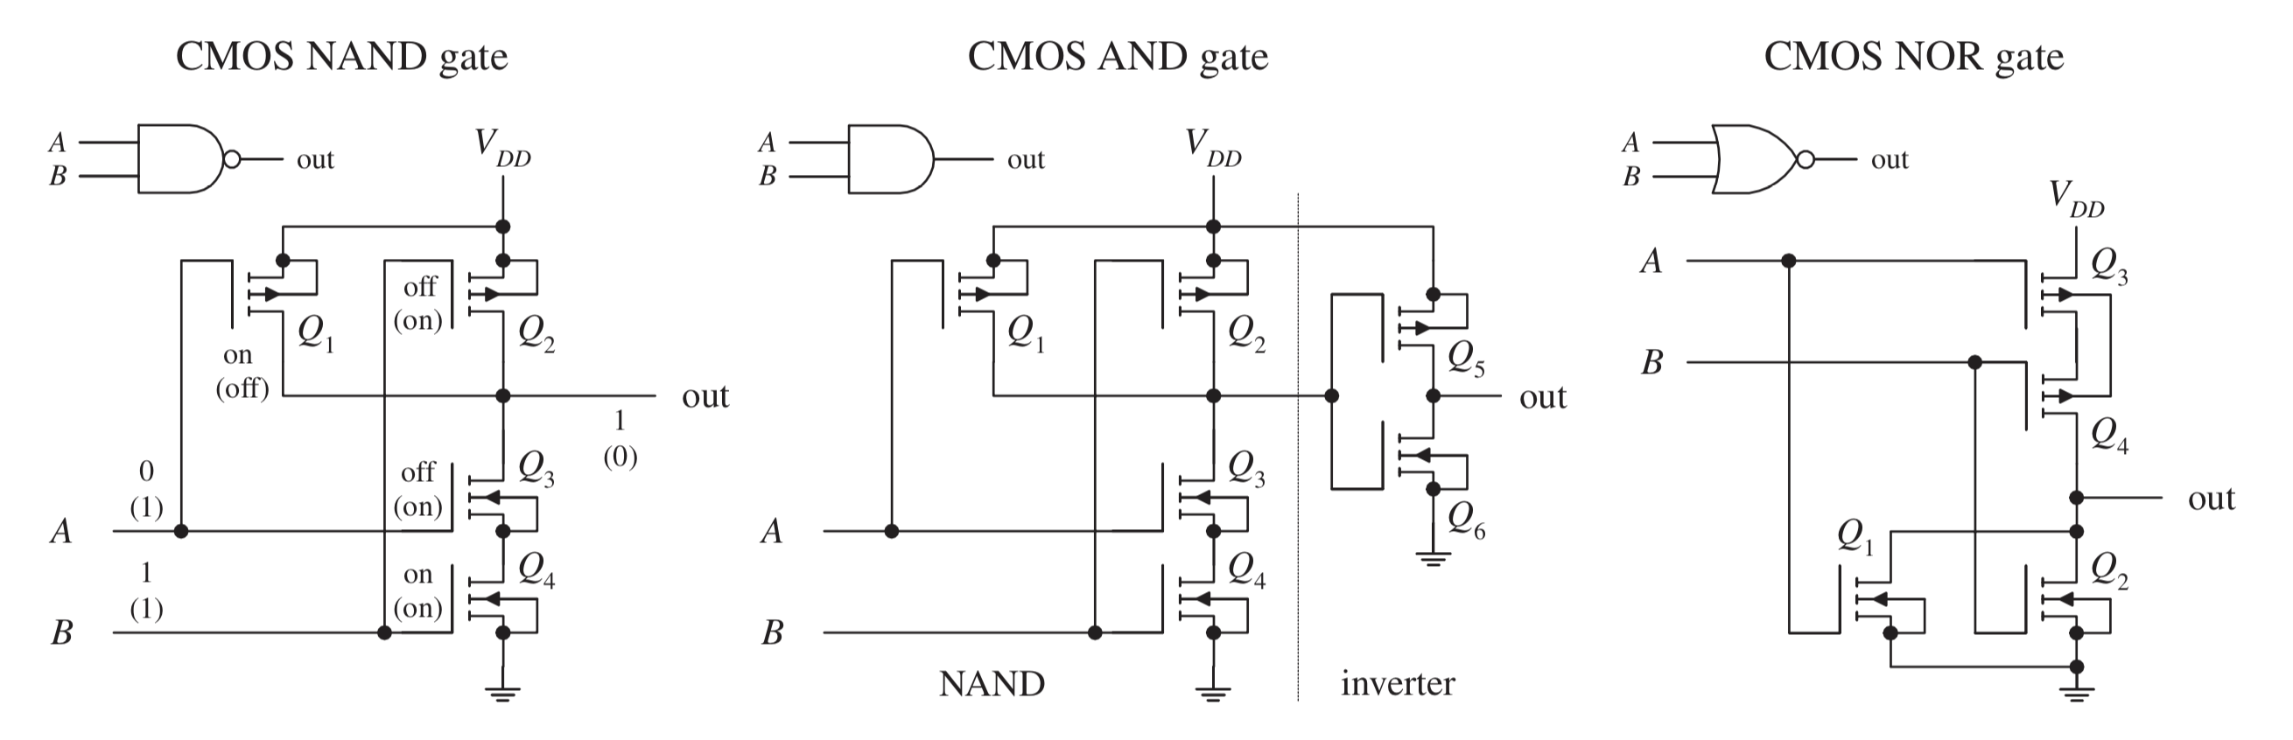
Notes:
try to figure out what maybe one of these does — leads into NAND, NOR universality
these are for some reason weird to figure out though…

Slide 36
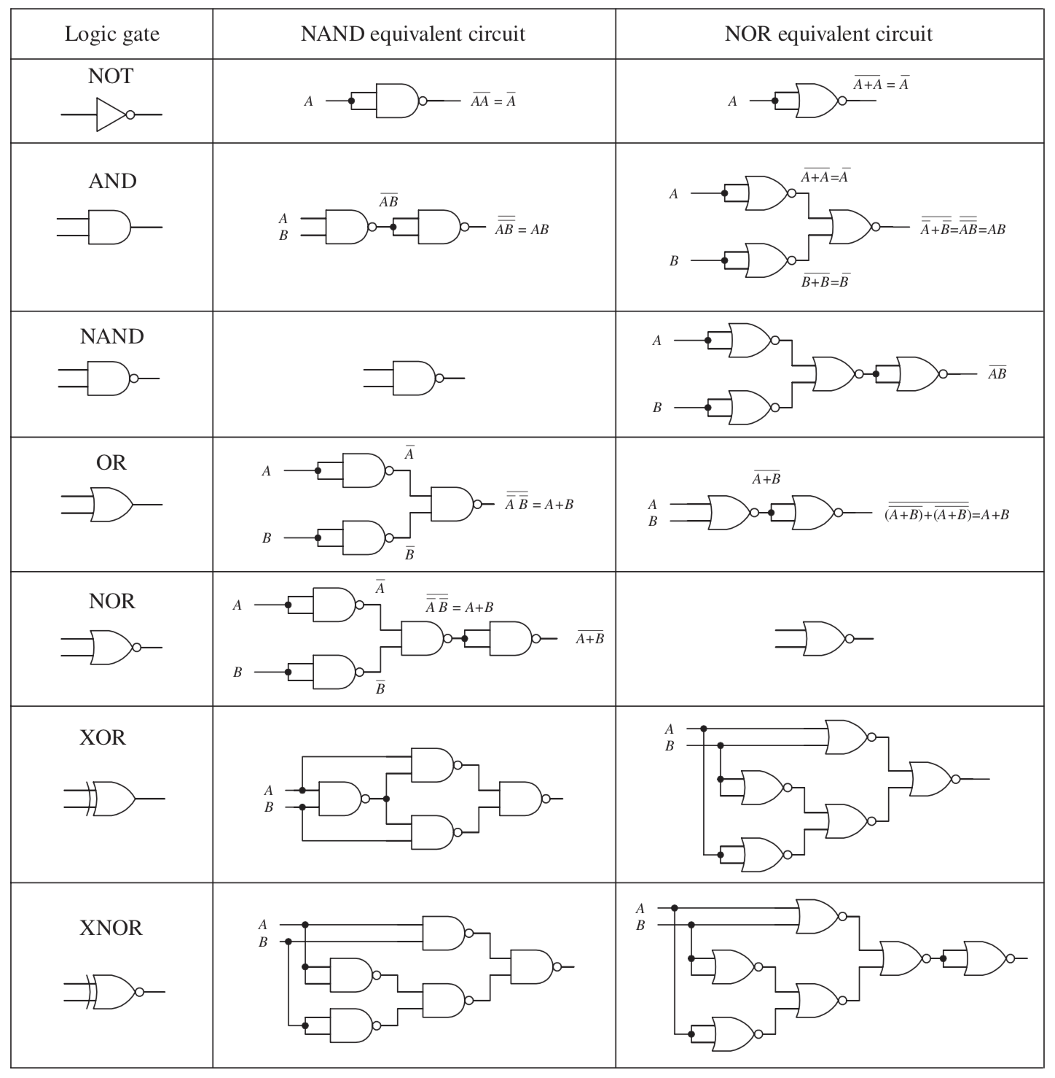
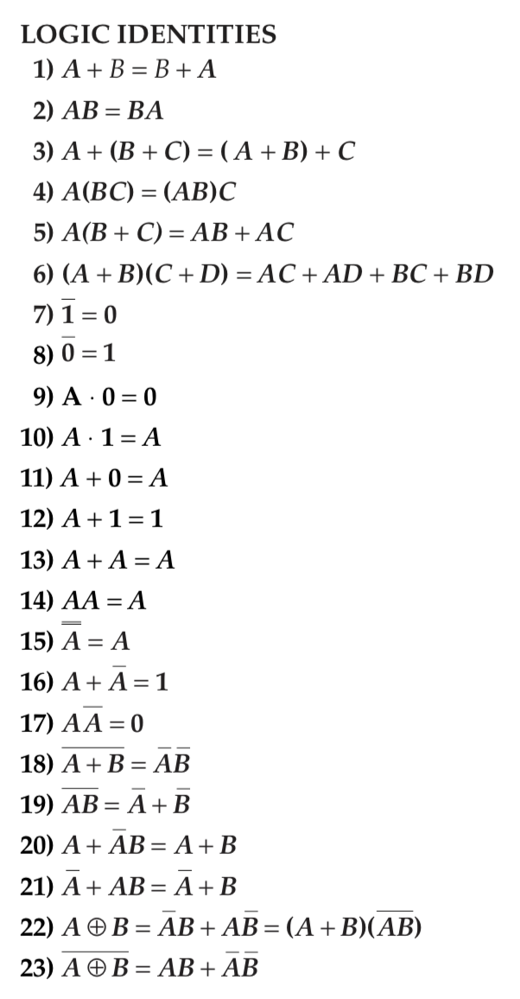
Notes:
de Morgan’s Law == (A+B)’ = A’B’ ; (AB)’ = A’ + B’
universal NAND and NOR equivalence
try to figure out what these gates are (maybe pick one of them)
(go through and make the truth table)

Slide 38
“Let’s count in Binary!”
0
1
2
3
4
5
6
7
8
9
10
11
12
13
14
15
…
33
0
1
10
11
100
101
110
111
1000
1001
1010
1011
1100
1101
1110
1111
…
00100001
1-bit: 2
8-bits: 256
16-bits: 65,536
32-bits: 4,294,967,296 (~4 billion)
64-bits: 18,446,744,073,709,551,616 (~18 quintillion)
128-bits: 340,282,366,920,938,463,463,374,607,431,768,211,456
(~340 undecillion)
Notes:
halving algorithm to convert decimal to binary
getting from binary to hex
how do you add binary numbers?
how do you get negative numbers? sign bit, ones complement, twos complement
how would you make a two’s complement circuit?

Slide 39
“Let’s count in Binary!”
0
1
2
3
4
5
6
7
8
9
10
11
12
13
14
15
…
33
0
1
10
11
100
101
110
111
1000
1001
1010
1011
1100
1101
1110
1111
…
00100001
1-bit: 2
8-bits: 256
16-bits: 65,536
32-bits: 4,294,967,296 (~4 billion)
64-bits: 18,446,744,073,709,551,616 (~18 quintillion)
128-bits: 340,282,366,920,938,463,463,374,607,431,768,211,456
(~340 undecillion)
Notes:
values = 2**num_bits

Slide 40
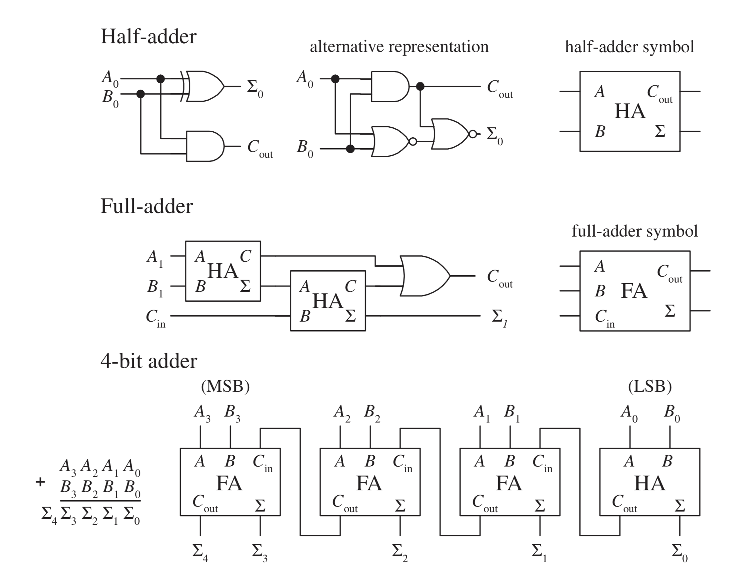
Notes:
this is what we’re building!

Slide 41
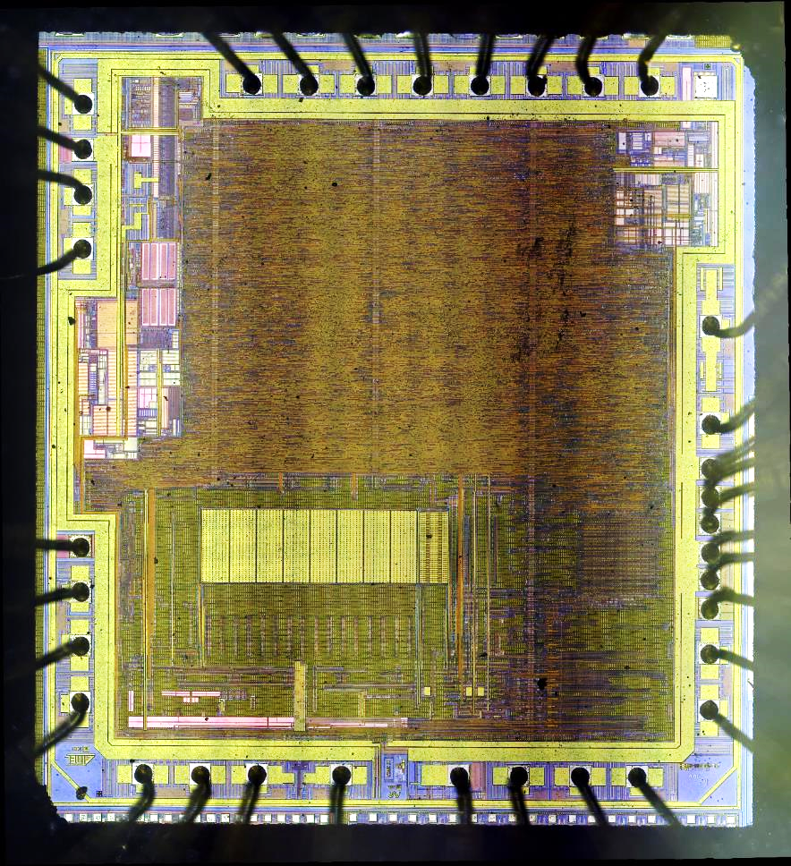
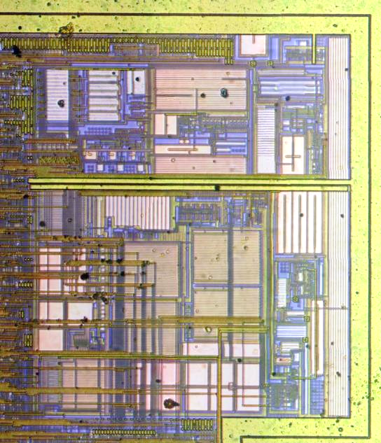
Atmel Mega 328P
ALU (arithmetic/logic unit)

Slide 42


Slide 43

Notes:
what’s this computer have that our adder won’t?
talk a little about clocks, sequential logic, latching, flip-flops, memory…

Slide 45
let’s make a thing

Slide 46




Computer Components (Anatomy)
Modern computers are built from a hierarchical arrangement of devices, the lowest level of which is a complimentary pair of transistor switches (CMOS).
Transistors
CPU
Micro
Logic Gates
Macro
RAM
Circuits

Slide 47


Circuits
Integrated combinations of logic gates that’s store data, process data, and move data around.
4002 320-bit RAM
The 74181 4-bit ALU
An ALU performs a specific logic function of 4 input bits based on a “control input” (instruction)
RAM can read or write bits values (0 or 1) at a specific location (address)

Slide 48






Computer Evolution
1970s
1980s
1990s
2000s
Arduino
Rasberry Pi

Slide 49

Notes:
brain chip akida SoC
neuromorphics

Slide 50
https://plato.stanford.edu/entries/computing-history/

